Slide 1
PCP Cloud Computing and DevOps

Slide 2
Compute-Linked Storage
EC2 Instance Storage
Definition: Ephemeral block-level storage attached physically to host.
Key Points:
High IOPS
Data lost when instance stopped/terminated
Use cases: temporary data, cache, buffer

Slide 3
Compute-Linked Storage
Elastic Block Store (EBS)
Persistent block storage for EC2
Features:
Independent of instance lifecycle
Replicated within AZ
Can attach/detach
EBS Volume Types
GP3, GP2 (general purpose SSDs)
io1/io2 (provisioned IOPS SSD)
st1 (throughput HDD)
sc1 (cold HDD)
EBS Multi-Attach
Attach single io1/io2 volume to multiple EC2 instances
Use case: clustered applications, HA setups

Slide 4
File Storage
Amazon Elastic File System (EFS)
Fully managed NFS file system
Scales automatically
Supports thousands of EC2s concurrently
EFS vs EBS
EBS → block-level, single instance (mostly)
EFS → shared file storage, multiple instances

Slide 5
Object Storage
Amazon S3 Overview
Object storage for internet-scale
Data stored as key-value pairs
99.999999999% durability
S3 Bucket Policies
JSON-based access control
Examples: restrict IP, enforce encryption

Slide 6
Object Storage
S3 Versioning
Maintains multiple versions of objects
Protects against accidental delete/overwrite
S3 Replication
Cross-Region Replication (CRR)
Same-Region Replication (SRR)
S3 Storage Classes
Standard, IA, One Zone-IA, Glacier, Glacier Deep Archive, Express One Zone

Slide 7
Object Storage
S3 Lifecycle Rules
Automates transition between classes
Example: Standard → IA → Glacier
S3 Requester Pays
Costs billed to data requester, not bucket owner
S3 Event Notifications
Trigger Lambda, SNS, SQS on object events
S3 Performance
Horizontal scaling, multi-part upload, parallelism

Slide 8
Object Storage
S3 Batch Operations
Bulk operations across millions of objects
Example: apply tags, ACL updates
S3 Storage Lens
Purpose: Centralised visibility into object storage usage and activity.
Provides organisation-wide insights across accounts and regions.
Use Cases: Detect cost optimization opportunities.

Slide 9
Object Storage
S3 Pre-Signed URLs
Purpose: Share temporary access to private objects in S3.
How it works:
Generated using AWS SDK or CLI with an expiration time.
URL includes signature + permissions.
Key Points:
Supports GET, PUT, DELETE operations depending on permissions.
Expiry can be set (seconds → hours, max 7 days for AWS SDK).
Does not require the requester to have AWS credentials.
Use Cases:
Securely share files with external users.
Uploading objects without exposing bucket credentials.
Temporary download links for customers.

Slide 10
Object Storage
S3 Access Points
Purpose: Simplifies managing access to shared datasets in S3.
Features:
Each access point has a unique hostname and access policy.
Policies can restrict access by VPC, IP, or user.
Designed for large-scale data lakes with hundreds of applications/users.
Works alongside bucket policies but provides granular, application-specific access control.
Use Cases:
Multi-tenant environments (e.g., analytics teams accessing shared data).
Enforcing stricter controls per application without complicating the main bucket policy.
Managing access to sensitive data in regulated industries.

Slide 11
EC2 Instance Store vs EBS vs EFS vs S3
Feature | Instance Store | EBS (Elastic Block Store) | EFS (Elastic File System) | S3 (Simple Storage Service)
Type | Block storage (ephemeral) | Block storage (persistent) | File storage (shared NFS) | Object storage
Persistence | Lost when instance stopped/terminated | Persistent until deleted | Persistent until deleted | Persistent until deleted
Scalability | Fixed (depends on instance type) | Scales up to petabytes per volume | Scales automatically (exabytes) | Virtually unlimited (exabytes)
Durability | Not durable (data loss on stop) | Replicated within AZ | Multi-AZ replication | 11 nines (99.999999999%)
Performance | Very high IOPS, low latency | High IOPS/throughput (depends on type) | Low-latency, scalable throughput | Optimized for large-scale throughput
Accessibility | Single EC2 instance only | Single EC2 (Multi-Attach for io1/io2) | Multiple EC2 instances across AZs | Accessed via API/HTTP endpoints
Cost | Free (included with EC2) | Pay per GB + provisioned IOPS/throughput | Pay per GB (scales automatically) | Pay per GB/month + requests
Use Cases | Caching, buffers, temp storage | Databases, boot volumes, enterprise apps | Web apps, content management, shared storage | Backups, static websites, data lakes

Slide 12
EBS Volume Types
Volume Type | Storage Type | Performance Focus | Max IOPS / Throughput | Cost ($/GB approx) | Typical Use Cases
gp3 | SSD | Balanced price/performance | 16,000 IOPS / 1,000 MB/s | Low | General workloads, dev/test
gp2 | SSD | General purpose (legacy) | 16,000 IOPS / 250 MB/s | Moderate | Standard apps, boot volumes
io1 / io2 | SSD | Provisioned IOPS (high) | 64,000 IOPS / 1,000 MB/s | High | Critical DBs, latency-sensitive apps
st1 | HDD | High throughput | 500 IOPS / 500 MB/s | Low | Big data, log processing
sc1 | HDD | Lowest cost | 250 IOPS / 250 MB/s | Very Low | Cold data, rarely accessed

Slide 13
S3 Storage Classes
Storage Class | Durability | Availability | Retrieval Time | Cost (per GB) | Use Cases
S3 Standard | 99.999999999% | 99.99% | Milliseconds | High | Frequently accessed data
S3 Standard-IA | 99.999999999% | 99.9% | Milliseconds | Lower | Infrequent but critical data
S3 One Zone-IA | 99.999999999% | 99.5% | Milliseconds | Lower | Infrequent data, non-critical
S3 Glacier Instant | 99.999999999% | 99.9% | Milliseconds | Low | Archival with fast access
S3 Glacier Flexible | 99.999999999% | 99.99% | Minutes to hours | Very Low | Long-term backups
S3 Glacier Deep Archive | 99.999999999% | 99.99% | Up to 12 hours | Lowest | Compliance, rarely accessed data
S3 Express One Zone | 99.999999999% | Zonal | Milliseconds | Premium | Ultra-low latency, high-frequency access

Slide 14
Poll Questions

Slide 15
Question 1
A tech company's developer team A has set up a application on an EC2 instance with an EBS volume attached in us-west-1a for the application to store data. After terminating the EC2 instances, the corresponding EBS volume is now available. Another team say team B attempts to attach it to an EC2 instance running in us-west-1b but is unsuccessful. What is the likely reason of this?
The team B does not have the necessary IAM permissions to attach the EBS volume.
EBS volumes are restricted to an AWS Region.
EBS volumes are locked to an Availability zone
EBS volume was restricted to an EC2 instance and cannot be reused

Slide 16
Question 1
A tech company's developer team A has set up a application on an EC2 instance with an EBS volume attached in us-west-1a for the application to store data. After terminating the EC2 instances, the corresponding EBS volume is now available. Another team say team B attempts to attach it to an EC2 instance running in us-west-1b but is unsuccessful. What is the likely reason of this?
The team B does not have the necessary IAM permissions to attach the EBS volume.
EBS volumes are restricted to an AWS Region.
EBS volumes are locked to an Availability zone
EBS volume was restricted to an EC2 instance and cannot be reused

Slide 17
Question 1
A tech company's developer team A has set up a application on an EC2 instance with an EBS volume attached in us-west-1a for the application to store data. After terminating the EC2 instances, the corresponding EBS volume is now available. Another team say team B attempts to attach it to an EC2 instance running in us-west-1b but is unsuccessful. What is the likely reason of this?
The team B does not have the necessary IAM permissions to attach the EBS volume.
EBS volumes are restricted to an AWS Region.
EBS volumes are locked to an Availability zone
EBS volume was restricted to an EC2 instance and cannot be reused

Slide 18
Question 1
A tech company's developer team A has set up a application on an EC2 instance with an EBS volume attached in us-west-1a for the application to store data. After terminating the EC2 instances, the corresponding EBS volume is now available. Another team say team B attempts to attach it to an EC2 instance running in us-west-1b but is unsuccessful. What is the likely reason of this?
The team B does not have the necessary IAM permissions to attach the EBS volume.
EBS volumes are restricted to an AWS Region.
EBS volumes are locked to an Availability zone
EBS volume was restricted to an EC2 instance and cannot be reused

Slide 19
Question 1
A tech company's developer team A has set up a application on an EC2 instance with an EBS volume attached in us-west-1a for the application to store data. After terminating the EC2 instances, the corresponding EBS volume is now available. Another team say team B attempts to attach it to an EC2 instance running in us-west-1b but is unsuccessful. What is the likely reason of this?
The team B does not have the necessary IAM permissions to attach the EBS volume.
EBS volumes are restricted to an AWS Region.
EBS volumes are locked to an Availability zone
EBS volume was restricted to an EC2 instance and cannot be reused

Slide 20
Question 1
A tech company's developer team A has set up a application on an EC2 instance with an EBS volume attached in us-west-1a for the application to store data. After terminating the EC2 instances, the corresponding EBS volume is now available. Another team say team B attempts to attach it to an EC2 instance running in us-west-1b but is unsuccessful. What is the likely reason of this?
The team B does not have the necessary IAM permissions to attach the EBS volume.
EBS volumes are restricted to an AWS Region.
EBS volumes are locked to an Availability zone
EBS volume was restricted to an EC2 instance and cannot be reused

Slide 21
Question 2
An EC2 instance with two EBS volumes has been launched by you. The Root volume type is used to store the OS, Jenkins, and configuration files, while the other EBS volume type is to store data. You intend to terminate the EC2 instance after a week. What's the default behavior that will happen to each EBS volume?
The EBS volume type and the root volume type will both be deleted
The root volume will be deleted and EBS volume will not be deleted
While the EBS volume will be deleted, the root volume will remain intact
The EBS volume type and the root volume type both won't be deleted.

Slide 22
Question 2
An EC2 instance with two EBS volumes has been launched by you. The Root volume type is used to store the OS, Jenkins, and configuration files, while the other EBS volume type is to store data. You intend to terminate the EC2 instance after a week. What's the default behavior that will happen to each EBS volume?
The EBS volume type and the root volume type will both be deleted
The root volume will be deleted and EBS volume will not be deleted
While the EBS volume will be deleted, the root volume will remain intact
The EBS volume type and the root volume type both won't be deleted.

Slide 23
Question 3
EC2 instances with EBS data volume attached recently started facing some issues, you were troubleshooting problem by detaching the volume, but it remain stuck in the detaching state for several minutes. What action you need to take to resolve this issue?
Force Detach
Detach Instance
AttachVolume
AttachInstance

Slide 24
Question 3
EC2 instances with EBS data volume attached recently started facing some issues, you were troubleshooting problem by detaching the volume, but it remain stuck in the detaching state for several minutes. What action you need to take to resolve this issue?
Force Detach
Detach Instance
AttachVolume
AttachInstance

Slide 25
Question 4
A media analytics startup stores video content and audience interaction logs in an Amazon S3 bucket located in the us-east-1 Region. To reduce latency and costs, the company wants the entire contents of the S3 bucket to be available in multiple Regions automatically, so that analysts in each Region (say europe and asia) can run data analysis locally without repeatedly fetching data from us-east-1. As a solution architect for the organization, which S3 feature should you use?
S3 Transfer Acceleration
use cloudFront distributions
S3 replication
Configure S3 Lifecycle Policies

Slide 26
Question 4
A media analytics startup stores video content and audience interaction logs in an Amazon S3 bucket located in the us-east-1 Region. To reduce latency and costs, the company wants the entire contents of the S3 bucket to be available in multiple Regions automatically, so that analysts in each Region (say europe and asia) can run data analysis locally without repeatedly fetching data from us-east-1. As a solution architect for the organization, which S3 feature should you use?
S3 Transfer Acceleration
use cloudFront distributions
S3 replication
Configure S3 Lifecycle Policies

Slide 27
Question 5
A solutions architect is planning a law firm's move from on-premises to AWS. The firm's infrastructure currently consists of numerous servers and 40 TB of data stored on shared NFS storage. Based on the requirements, he recommended S3 as a storage option; however, which AWS service should he use to to efficiently migrate the large amounts of data quickly and securely from on-premises to S3?
AWS Storage
Tape Gateway Amazon EBS
AWS Transfer
Family AWS DataSync

Slide 28
Question 5
A solutions architect is planning a law firm's move from on-premises to AWS. The firm's infrastructure currently consists of numerous servers and 40 TB of data stored on shared NFS storage. Based on the requirements, he recommended S3 as a storage option; however, which AWS service should he use to to efficiently migrate the large amounts of data quickly and securely from on-premises to S3?
AWS Storage
Tape Gateway Amazon EBS
AWS Transfer
Family AWS DataSync

Slide 29
Question 6
A bioinformatics company publishes protein datasets in an S3 bucket named bioinformaticsbucket. The corporation chose to make the datasets available to the public and data-analyst, so they can study and research on them. As the company's solution architect, you made the security decision to publish this database via FTP rather than making the S3 bucket public. What should you do to complete the requirement efficiently and with the least effort?
Use AWS Transfer Family
AWS Storage Gateway-volume gateway
Create EC2 instances with FTP server installed, then copy data from S3 (bioinformaticsbucket) to the EC2 instance.
Copying data from S3 (bioinformaticsbucket) to an EFS file system and exposing it over FTP.

Slide 30
Question 6
A bioinformatics company publishes protein datasets in an S3 bucket named bioinformaticsbucket. The corporation chose to make the datasets available to the public and data-analyst, so they can study and research on them. As the company's solution architect, you made the security decision to publish this database via FTP rather than making the S3 bucket public. What should you do to complete the requirement efficiently and with the least effort?
Use AWS Transfer Family
AWS Storage Gateway-volume gateway
Create EC2 instances with FTP server installed, then copy data from S3 (bioinformaticsbucket) to the EC2 instance.
Copying data from S3 (bioinformaticsbucket) to an EFS file system and exposing it over FTP.

Slide 31
Questions and Discussions

Slide 32

Thank You!

Slide 34

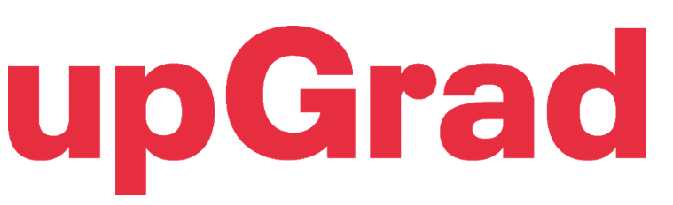
DevSecOps

Slide 35
Overview
DevSecOps stands for Development, security and Operations. It is extension of DevOps practices.
Security means introduction of security practices in software development cycle. Each coder ensures the code are free of security vulnerability and security practice as the part of software lifecycle.
During the code push, when we plan CICD pipeline, Security and Code scanning become the part of our normal CICD cycle.
The primary goal is to identify vulnerabilities early in the development cycle.

Slide 36
Software Development Lifecycle
The Software Development Lifecycle (SDLC) is a systematic framework designed to help software teams create high-quality applications. By following the SDLC, teams can lower costs, reduce errors, and ensure the software consistently meets project objectives.
Phases:
Requirement Analysis
Planning
Software Development
Testing
Deployment

Slide 37
Benefits of DevSecOps
Identify software vulnerabilities at an early stage
Accelerate time to market
Maintain adherence to regulatory requirements
Foster a culture of security awareness
Implement new features with security

Slide 38
Identify software vulnerabilities
Software teams prioritize security controls throughout the entire development lifecycle. Rather than waiting until the software is finished, they perform checks at each stage.
This enables teams to identify security issues early, reducing both the cost and time required to address vulnerabilities.
As a result, users benefit from a more secure application with minimal disruption post-release.

Slide 39
Development Efficiency and Compliance
DevSecOps enables software teams to automate security tests, minimizing human errors and ensuring that security assessments do not slow down the development process.
By adopting best practices and technologies for security, software teams utilize DevSecOps to meet regulatory requirements.
They identify system data protection and security needs, such as using AWS Security Hub to automate security checks aligned with industry standards.

Slide 40
Security Awareness and Collaboration
Software teams become more attuned to security best practices during application development. They proactively identify potential security vulnerabilities in the code, modules, or technologies used in building the application.
DevSecOps promotes seamless collaboration between development, operations, and security teams. With a shared understanding of software security and the use of common tools for automating assessments and reporting, all teams focus on delivering greater value to customers without sacrificing security.

Slide 41
How DevSecOps works?
DevSecOps integrates security into the DevOps process by embedding security assessments throughout the CI/CD pipeline. It turns security into a collective responsibility for all team members involved in software development.
The development team works closely with the security team before writing any code, while operations teams continue to monitor the software for security concerns after deployment.
This approach enables companies to deliver secure software more quickly while maintaining compliance

Slide 42
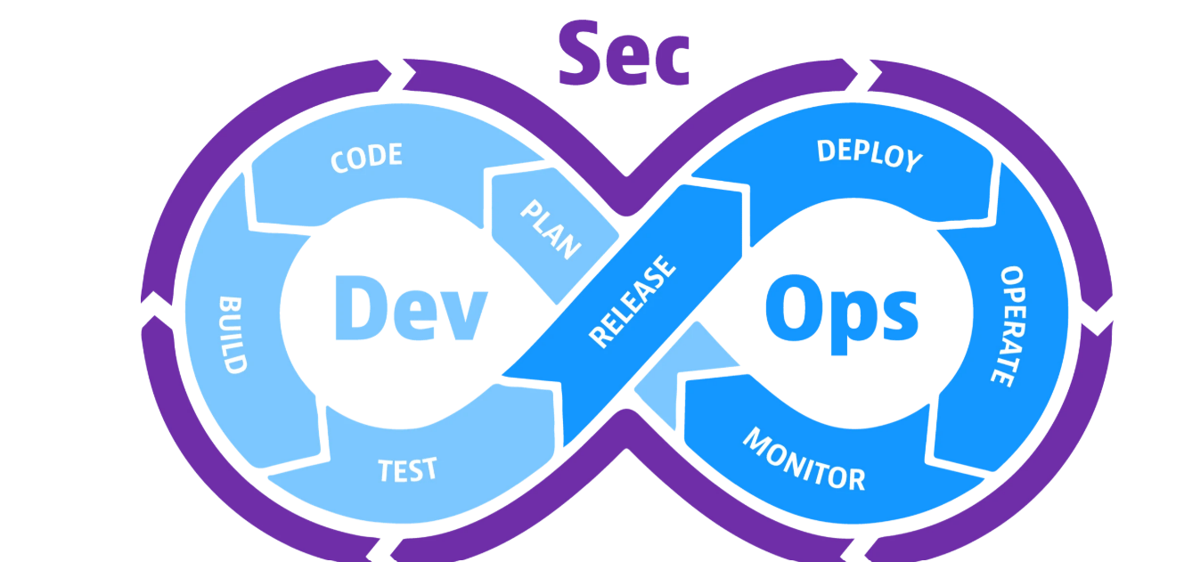

Slide 43
Devops vs devsecops
DevOps is a methodology that unites development, operations, and security teams to accelerate the software development lifecycle.
DevSecOps enhances this by embedding security into the DevOps process from the outset. It ensures security is prioritized throughout the entire software development lifecycle, rather than being an afterthought.
Key differences between DevSecOps and DevOps include:
DevSecOps involves a wider range of stakeholders, including security teams.
DevSecOps mandates a more thorough approach to security testing and scanning.
DevSecOps emphasizes stronger compliance with security regulations.

Slide 44
Devops vs devsecops
Features | Devops | Devsecops
Focus | Speed and Agility | Security
When to start security testing | Later in dev | From the start of CICD
Who is responsible for security | Security Team | Everyone
Culture | Security aspects most of team are not aware about practices, take as barrier in speed of release | Security is everyone responsibility, everyone will aware about the process

Slide 45
DevSecOps Principles
Shift left :Shift left is the process of checking for vulnerabilities in the earlier stages of software development. By following the process, software teams can prevent undetected security issues when they build the application. For example, developers create secure code in a DevSecOps process.
Shift right :Shift right indicates the importance of focusing on security after the application is deployed. Some vulnerabilities might escape earlier security checks and become apparent only when customers use the software.

Slide 46
Shift left: Culture
Security should be a standard requirement
Product managers and engineers should always be challenged
Understand and prioritize end-user needs in services
All components should be considered by ethical hackers
Innovation driven by manual ethical hacking techniques

Slide 47
Shift left: Automation
Inclusion of security in CI/CD pipeline
SAST (statistical analysis)
DAST (dynamic analysis)
Security code coverage analysis
Digitally signed secure repositories for built binaries
Penetration tests
Smoke tests

Slide 48
Shift left: Lean
Security-integrated definitions
Security-focused designs
Security-driven engineering
Security-inclusive testing
Security-conscious deployments

Slide 49
Reactive: Shift right [culture]
Adopt the mindset that no system is completely invulnerable
Conduct production smoke testing from the very beginning as part of monitoring and observability
Apply chaos engineering in both production and non-production environments
Perform root cause analysis using real-time data capture

Slide 50
Automation and Lean Practices
Continuously monitor security in both production and non-production environments
Implement chaos engineering with automated security testing in production
Treat major incident management as a value stream—every second matters!
Minimize response times to halt an attack
Speed up response times to restore value
Provide feedback to engineering to prevent future issues and address technical debt

Slide 51
Common factors: Measurements
Security professionals define measures based on regulatory requirements, such as GDPR
Measure security in both production and non-production environments
Define security as a key part of business value and success criteria
Real-time updates of security scorecards

Slide 52
Sharing
Every part of the organization should take responsibility for security
The ability to independently identify and implement security measures
In case of an attack, a security-led damage analysis team, supported by IT, should work alongside an IT-led remediation team, supported by security
Leadership should empower teams with shared accountability in a safe environment, including red team vs. blue team exercises and security drills

Slide 53
DevSecOps tools
Static application security testing: Static application security testing (SAST) tools analyze and find vulnerabilities in proprietary source code.
Software composition analysis: Software composition analysis (SCA) is the process of automating visibility into open-source software (OSS) use for the purpose of risk management, security, and license compliance.
Interactive application security testing: DevSecOps teams use interactive application security testing (IAST) tools to evaluate an application’s potential vulnerabilities in the production environment. IAST consists of special security monitors that run from within the application.
Dynamic application security testing:Dynamic application security testing (DAST) tools mimic hackers by testing the application's security from outside the network.

Slide 54
Challenges: Culture and Adoption
The first challenge involves people and culture. You might find it necessary to retrain the people on your DevOps teams so they understand security best practices and know how to operate your new security tooling.
In terms of culture, your teams need to truly adopt the mindset that they’re responsible for the security of the software they build and deploy, just as much as they’re responsible for feature, function, and usability.

Slide 55
Finding the Right Tool
A second challenge is finding the right security tooling and integrating it into your DevOps workflow.
The more automated your DevSecOps tooling is, and the more integrated it is with your CI/CD pipeline, the less training and culture-shifting you need to do.

Slide 56
Aws: DevSecOps Implementation
AWS supports modern DevSecOps practices so that software teams can automate their applications’ security, compliance, and data protection. For example, you can do the following:
Use Amazon Inspector for automated and continual vulnerability management at scale.
Use AWS CodeCommit to manage source control and make incremental changes to the application.
Use AWS Secrets Manager to easily rotate, manage, and retrieve database credentials, API keys, and other secrets through their lifecycle.

Slide 57
Thank You!

Slide 58
SCANNING TOOL

Slide 59
SBOM
In today’s digital age, every piece of software we use is like a puzzle made of different smaller parts from various sources. A Software Bill of Materials (SBOM) is a list that tells exactly what these parts are.
If there’s something bad in the software, like a security weakness, the SBOM helps us find and fix it quickly, keeping our computers and information safe.
An SBOM can help us find out where the bad part is in the software so we can fix it before it causes problems.

Slide 60
SET UP
Prerequisites
An AWS account
Activate Amazon Inspector.
An EC2 instance (aws linux)

Slide 61
DEFINITION
A Software Bill of Materials (SBOM) is a comprehensive and formally organized inventory of the components, libraries, and modules necessary for the construction (i.e., compilation and linking) of a specific software application, along with the supply chain connections among these elements. The components listed may be open source or proprietary, available at no cost or for a fee, and can range from widely accessible to those with restricted access.
Software producers use SBOMs to help create and maintain the software they deliver. Software buyers use SBOMs to evaluate software before purchasing, negotiate discounts, or plan how to deploy it. Software operators use SBOMs to manage vulnerabilities, track assets, handle licensing and compliance, and quickly identify dependencies and supply chain risks in the software and its components.

Slide 62
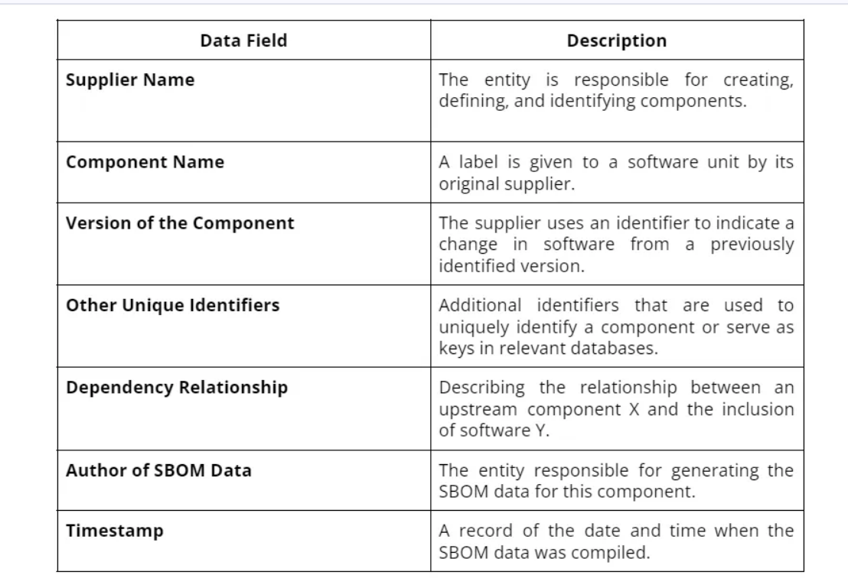
FIELDS OF SBOM

Slide 63
System Package Data Exchange (SPDX®) : A universally accepted standard that can depict systems comprising software components in the form of Software Bills of Materials (SBOMs) along with Artificial intelligence, data, and security references facilitating a diverse array of risk management applications.
CycloneDX is engineered to enhance supply chain functionalities aimed at mitigating cyber risks. It is compatible with more than 200 tools spanning over 20 programming languages and is endorsed by prominent organizations such as Lockheed Martin, ServiceNow, IBM, Contrast Security, Sonatype, among others.

Slide 64
SBOMGEN
Besides the capability of Inspector that can generate SBOMs of EC2, Lambdas, container images, and repositories, it also provides a tool to generate them manually. The Amazon Inspector SBOM Generator (refered as Sbomgen from now on) tool is designed to create an SBOM for various entities such as archives, container images, directories, local systems, and compiled binaries.
This tool operates by identifying files that detail the installed packages. Sbomgen extracts essential data like package names, versions, and additional metadata upon locating such files. It then converts this package information into an SBOM formatted in CycloneDX.

Slide 65
LAB FOR SBOM
Ubuntu ec2 vm
Setup tools
Scan tools

Slide 66
OBSERVATION
Sbomgen is compatible exclusively with Linux operating systems.
To enable Sbomgen to examine locally stored images, Docker needs to be installed on your system. However, Docker installation is not necessary for analyzing images exported as .tar files or by those stored in remote container registries.
Sbomgen offers flexibility in its use; it can function independently to produce a CycloneDX-formatted SBOM as a file or output directly to STDOUT. Additionally, it can transmit SBOMs to Amazon Inspector to facilitate the process of vulnerability detection.

Slide 67
VULNERABLE PYTHON SCRIPT
Accurate Dependency Tracking: It enables swift and precise pinpointing of each dependency’s location, which is particularly beneficial for finding deeply nested dependencies that are typically challenging to track.
Improved Risk Assessment: Knowing the exact routes of dependencies allows for a more effective evaluation and mitigation of security threats linked to those dependencies.
Efficiency in Time and Resources_ This level of detail cuts down on the effort and resources required for manually tracing and analyzing dependencies, making the process of managing vulnerabilities more efficient.
Greater Clarity and Openness: It offers a more transparent view of the application’s dependency framework, leading to enhanced management and upkeep.

Slide 68
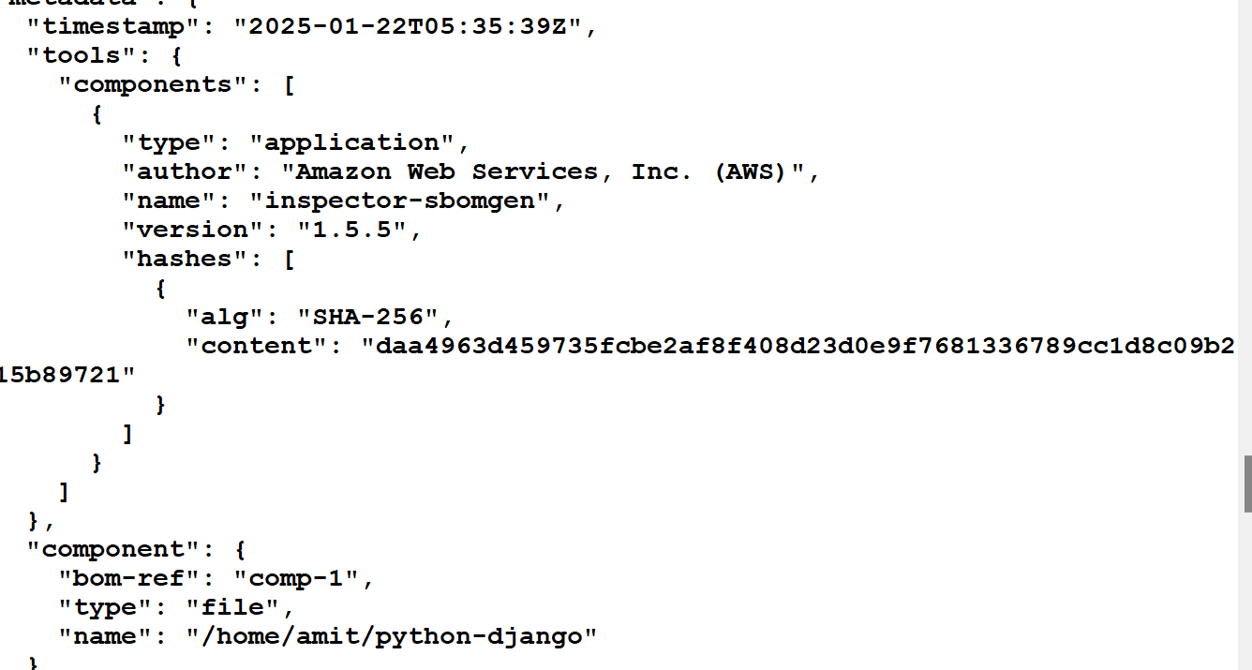
LAB
Scan sample code from python

Slide 69
Thank You!

Slide 70
AWS Inspector

Slide 71
Overview
AWS Inspector is a vulnerability scanning service by AWS that is used to scan your EC2 instances, container images, and Lambda functions.
Its findings will report vulnerabilities known as CVE’s (Common Vulnerabilities and Exposure) which are computer security flaws that are made public with the intention of bringing awareness and transparency.
If your AWS environment has multiple accounts, you can centrally manage your environment through a single account by using AWS Organizations. Using this approach, you can designate an account as the delegated administrator account for Amazon Inspector.

Slide 72
CVE
The US Government maintains a database of vulnerabilities with data such as risk score, product name, references, remediation and more. This database is known as the National Vulnerability Database(NVD) and is the source for many companies when trying to understand the impact of each vulnerability. Amazon Inspector uses the NVD score in many of its vulnerabilities.
A CVE naming convention will normally start with CVE followed by the year the vulnerability was discovered and then followed by a unique order number. Additionally, a profile of the vulnerability such as the severity, and in some cases how to “remediate” is updated frequently to keep users informed.

Slide 73
Scan types
Amazon EC2 scanning: This scan type extracts metadata from your EC2 instance before comparing the metadata against rules collected from security advisories. When you activate this scan type, Amazon Inspector scans all eligible instances in your account for package vulnerabilities and network reachability issues.
Amazon ECR scanning: This scan type scans container images in Amazon ECR. When you activate this scan type, you change the scanning configuration setting for your private registry from basic scanning to enhanced scanning

Slide 74
Demo: AWS Inspector Dashboard

Slide 75
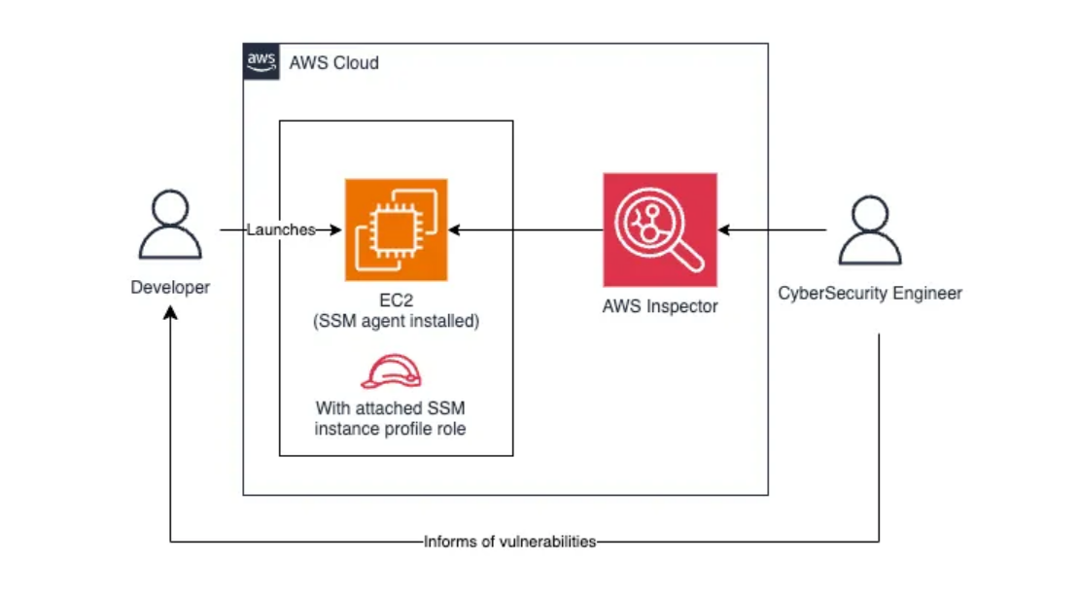
EC2 Scan

Slide 76
EC2 Scan
At a high level, AWS Inspector is dependent on an agent to be installed in the EC2 instance that will be used to scan and report the security findings.
Additionally, the EC2 will need a role that grants SSM to reach the EC2 instance.
AWS Inspector uses the SSM agent to connect to the instance
AWS Inspector can be supported at the organizational level and scan all accounts in the organization; however, the scope of this blog will be a single account.

Slide 77
Demo: EC2 Instance Scanning
Notes:
Create a SSM role
Setup aws ec2 instance (aws linux)
Login to aws instance and check
Check the inspector dashboard
Update the role
Again check the Report

Slide 78
Hands-On: Activating Inspector

Slide 79
Use Cases
A three-tier application consists of three layers:
presentation (web server)
application (business logic)
database (data storage)
AWS Inspector can play a critical role in monitoring the web server tier for vulnerabilities and misconfigurations. Here's an example scenario:

Slide 80
Use Cases
Presentation Layer (Web Server):
Amazon EC2 instances running NGINX or Apache as the web server.
Serves static and dynamic content to end users.
Application Layer:
EC2 instances or containerized microservices running application logic.
Interacts with the database and processes business logic.
Database Layer:
Amazon RDS or self-managed database on EC2 instances.
Stores application data securely.

Slide 81
SBOM Generator
A Software Bill of Materials (SBOM) is a formally structured list of components, libraries, and modules required to build a piece of software.
The Amazon Inspector SBOM Generator (Sbomgen) is a tool that produces an SBOM for archives, container images, directories, local systems, and compiled Go and Rust binaries.
Sbomgen scans for files that contain information about installed packages. When Sbomgen finds a relevant file, it extracts package names, versions, and other metadata.
Sbomgen then transforms package metadata into a CycloneDX SBOM. You can use Sbomgen to generate the CycloneDX SBOM as a file or in STDOUT and send SBOMs to Amazon Inspector for vulnerability detection.

Slide 82
Workflow
Deployment:
A new EC2 instance is provisioned with an NGINX web server as part of the CI/CD pipeline.
The pipeline triggers an Inspector scan after the server is configured.
Assessment:
Inspector scans the EC2 instance for:
Vulnerabilities in the NGINX version (e.g., CVE-2023-XXXX).
Unnecessary open ports (e.g., Port 22 left open to all).
Outdated or misconfigured OS components.
Findings:
Inspector identifies:
A critical CVE in the deployed NGINX version.
The web server is running with default configurations, exposing unnecessary headers.
Remediation:
Update the NGINX version to a secure release.
Apply recommended configurations to the web server (e.g., disabling unnecessary modules).
Post-Remediation Scan:
Run another Inspector scan to validate that the vulnerabilities have been resolved.

Slide 83
Thank You!

